Slide 1

STRESS MANAGEMENT
BY
OGUANYIA CYNTHIA

Slide 2
INTRODUCTION
Work-related stress is a negative response to work demands that exceed a person's coping ability. It can cause physical, mental, emotional, and behavioral responses.
What causes work-related stress?
Unmanageable pressure: When the demands of a job are greater than a person's ability to manage, it can lead to stress.
Role conflict: Workers face incompatible demands and are pulled in conflicting directions.
What are the effects of work-related stress?
Poor health: Work-related stress can lead to poor health and even injury.
Mental health issues: It can intensify mental health issues like anxiety and depression.

Slide 3
PROBLEM STATEMENT
Stress is a significant challenge impacting the overall well-being and productivity of our workforce. This project seeks to analyse the key sources of stress, evaluate the effectiveness of coping mechanisms, and recommend strategies for improving stress management within the organization.

Slide 4
RECOMMENDATION
Healthy habits like rest and art are promoted through wellness initiatives, peaceful areas, and artistic programs.
Establish a focused program for stress relief.
Encourage good coping strategies
Promote sleep quality via education, resources like sleep trackers, and ensuring work-life balance policies.
Financial wellness program.
To assess stress over time, form a wellness committee.
Provide access to professional counseling for chronic stress management.

Slide 5
OBJECTIVES
To determine the main cause of stress that affects workers in various departments.
To examine the effect of stress on the quality of sleep.
To evaluate the efficiency of the coping mechanism in use today.
To suggest practical measures to lower stress and improve worker wellbeing.

Slide 6
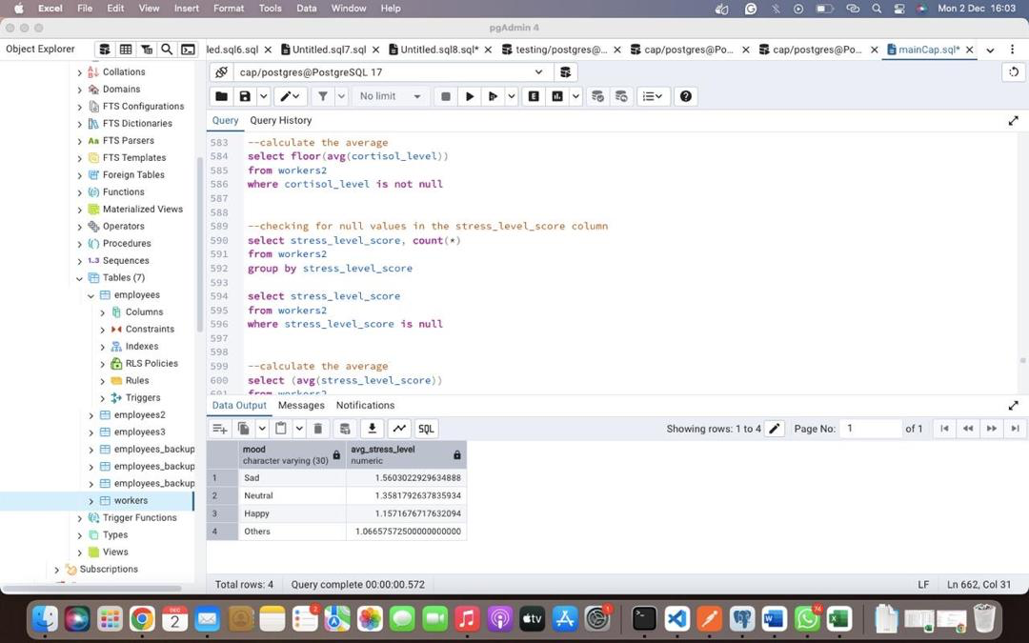
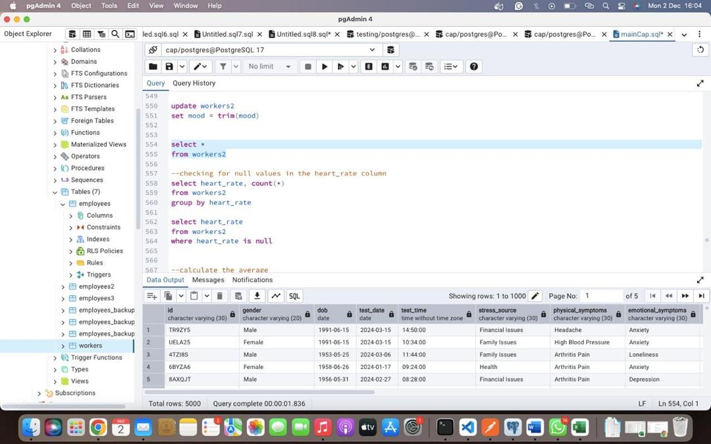
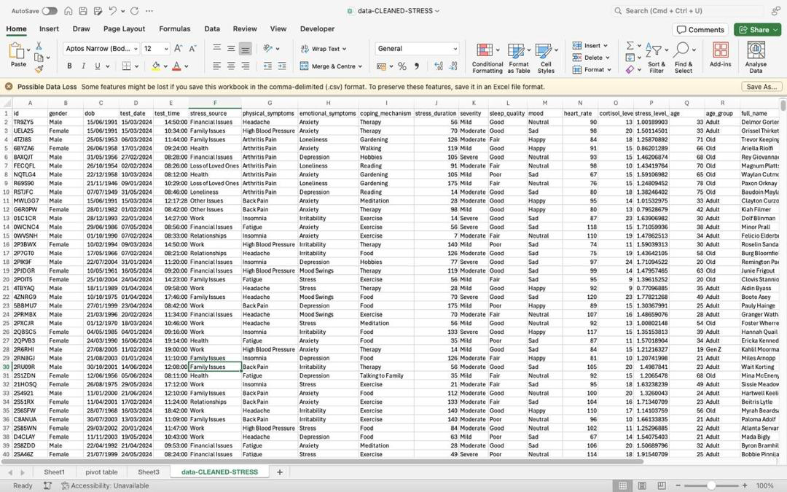
DATA CLEANING

Slide 7
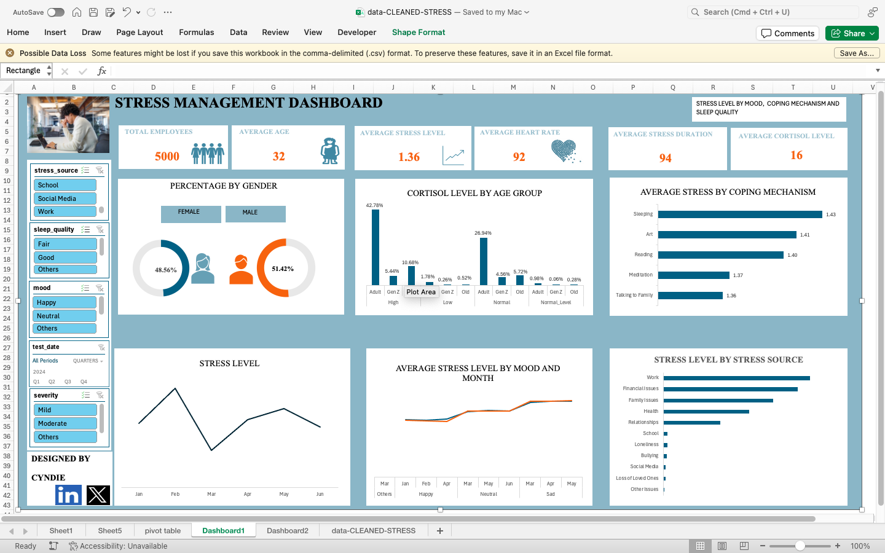
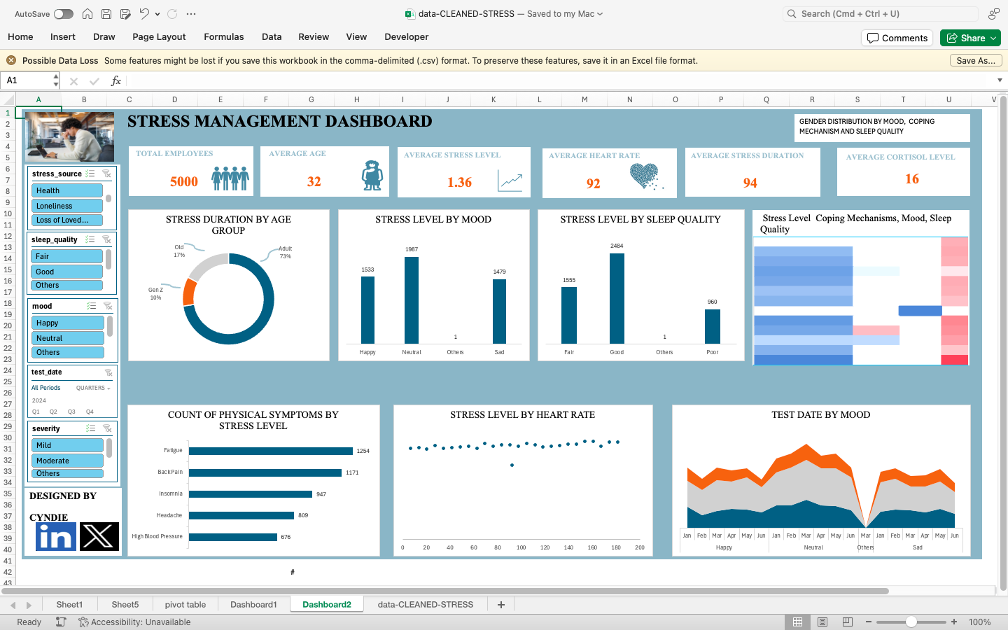
DASHBOARD

Slide 8


INSIGHTS
PERCENTAGE BY GENDER
FEMALE
MALE
This Percentage by Gender chart shows a nearly equal gender distribution within the workforce:
Male employees make up 51.42%.
Female employees account for 48.56%.
Equal distribution also presents an opportunity to promote workplace diversity and ensure that wellness programs are inclusive and equitable.

Slide 9
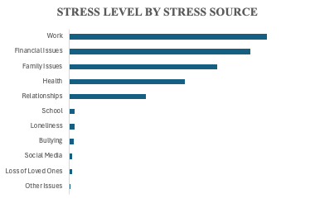
INSIGHTS
Work related stress happens to be the most stess source due to work-related pressure.
Financial issues also contribute the the stress source.

Slide 10
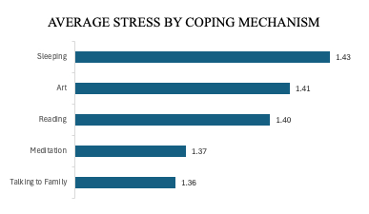
INSIGHTS
From this chart, it shows that sleeping and art has a way of reducing stress so the employers should always give atleast an hour for rest.

Slide 11
INSIGHTS
It shows that January and Febuary has the highest stress level.

Slide 12
CONCLUSION
This project analyzed the employee stress data and developed a dashboard using Excel features to help the HR monitor the different stress indicators. The insights from the various stress levels, stress sources, and other factors provide valuable input for designing more effective stress management programs. Other factors, like external sources of stress, should also be considered.

